Slide 1
Availability, scalability and Resiliency options for RDS
Aws RDS High Availability with multi-AZ
AWS RDS scalability with read replica
Other Considerations for a relational DB

Slide 2
Availability – what it looks like…
Availability | Max Downtime
99 | 3d, 15h
99.9 | 8h, 45m
99.95 | 4h, 22m
99.99 | 52 min
99.999 | 5 min

Slide 3
Reliability Design Principles ~ directly impacting the DB availability
Auto Recovery
Monitoring and Auto-Scaling (Vertical and Horizontal)
Testing recovery plans
Use failure simulation - fault injection queries to induce failure into the DB and fine tune to meet recovery objectives
Create a playbook for failover and test it frequently

Slide 4
Multi-AZ – What and why?
Multi-AZ database – a prerequisite for Failover
Helps both RTO/RPO
Failover target for outage and planned maintenance. ~1min
Uses synchronous replication
No I/o interruption to DB during back ups
Patches and upgrades first performed on stand-by
Primary (R/W) - Standby (failover) – For higher availability and increased resiliency
What MULTI-AZ is not?
Not a read only instance
Is not active for traffic until the failover happens i.e. no DB engine running to serve
No asynchronous replication and no replication lag

Slide 5
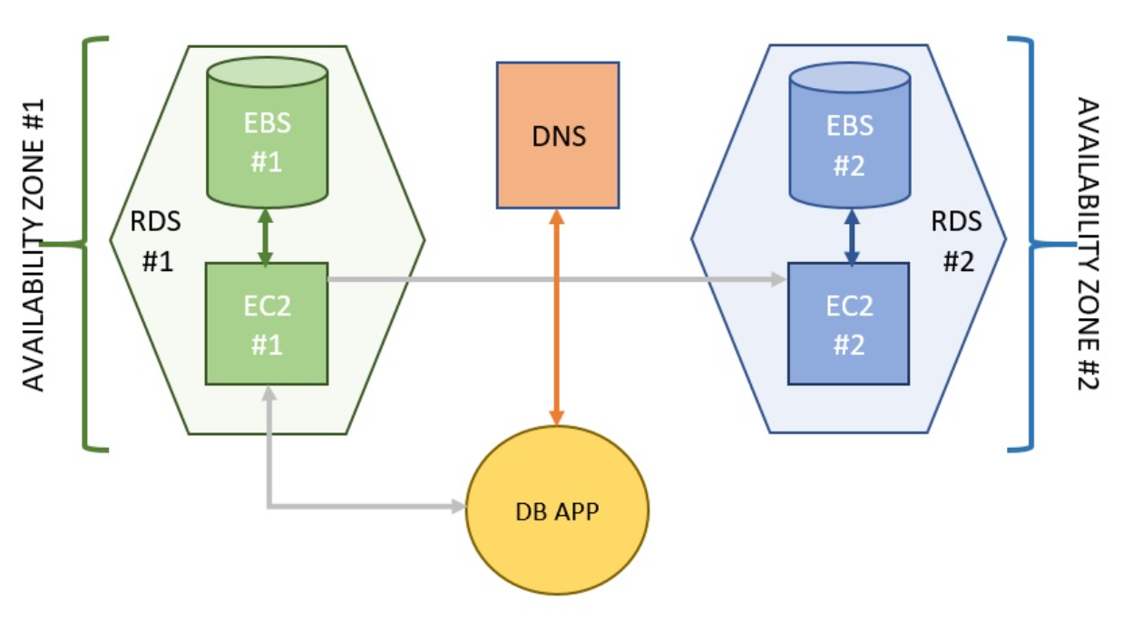
Multi-AZ process – how?
High-level multi-AZ creation
AWS Starts taking snapshot of primary DB
Tip: do this when app traffic is low to avoid latency issues
Copy snapshot to AZ#2
Restore DB from snapshot in AZ#2
Configure synchronous replication

Slide 6
(Auto) DB Failover – How?
Primary DB connections are stopped and DNS for cluster endpoint is updated
DNS: A-record updated to AZ#2-DB endpoint
Tip: keep app/jvm TTL for DNS caching to low or none
RDS brings up the DB instance and validates internal health check before considering the DB operational
What scenarios are covered in the auto-failover?
Storage failure could be because of a surge failure – Auto swapping of the underlying EBS volume by using the last stable snapshot and restoring the DB
Network interruptions: Like a complete disconnection to the DB or major packets of data loss determined by AWS that also results in failed health check anyway
Loss of availability – Actual hardware failure or AZ failure/outage
https://aws.amazon.com/blogs/database/amazon-rds-under-the-hood-multi-az/

Slide 7
What next…
Reminder of the AWS responsibility model;
Performance issues in application due to memory/CPU/DB locks/Storage queuing are the responsibility of the AWS user
AWS tooling that can help;
Performance insights and CloudWatch alarms/events
Enhanced monitoring for the underlying OS stats
Read - Amazon RDS Under the Hood: Multi-AZ
RTO/RPO and disaster recovery of the DB

Slide 8
DB Failover
DEMO
Manual
Automatic

Slide 9
Read replica – What, WHY
What?
Secondary copies of the writer instance to achieve higher performance and durability
Up to 5 read replicas. SQL server only allows in enterprise edition and multi-AZ only
Cross-region replica (with default parameter and security group) – DR++
Can be manually promoted to a standalone database instance
NO Replica chaining
Replication lag and CloudWatch alarms
Why?
Scale workloads by offloading read requests primary writer instance to reader endpoint
Why? – Blocking queries, write locks to the table along with very high traffic can lead to long wait times for query executions, causing timeout effects in the application layer
For disaster recovery (region outages too)– better resiliency
Business reporting usecases
Keeping read traffic on when your DB is undergoing maintenance and unavailability

Slide 10
Read replica – How?
Enable auto backup for primary DB
Console, API
To create replicas in same or other region than the primary
Additional reads:
Set up weighted DNS routing policy across multiple read replicas
Promoting read replica to a standalone DB
Note: Amazon RDS is also currently working on an optimization (to be released shortly) such that if you create multiple Read Replicas within a 30 minute window, all of them will use the same source snapshot to minimize I/O impact (“catch-up” replication for each Read Replica will begin after creation).

Slide 11
Summary
Multi-AZ – What and why?
DB Failover Demo – manual and automatic
Read Replicas – What and why? Readonly/failover?
Read Replica Demo
Sum it up: The “source” Multi AZ-DB instance provides you with enhanced write availability and data durability, and the associated read replica would improve read traffic scalability.

Slide 12
Thank You

